Slide 1

EMI教學資源中心
ESAP課綱發展規劃報告
國立中興大學 雙語教學推動資源中心
報告者: 邱奕穎 主任/ 生物化學研究所 教師

Slide 2
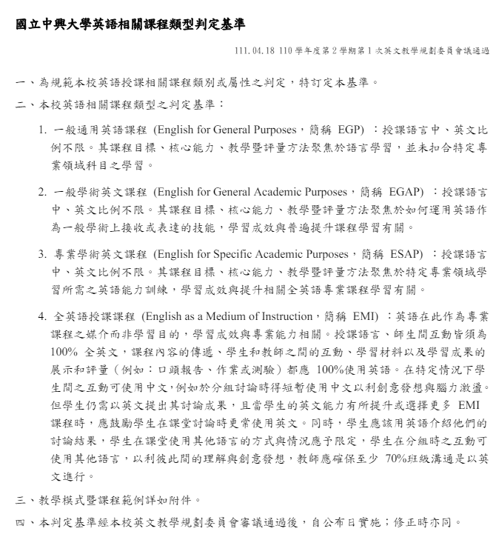
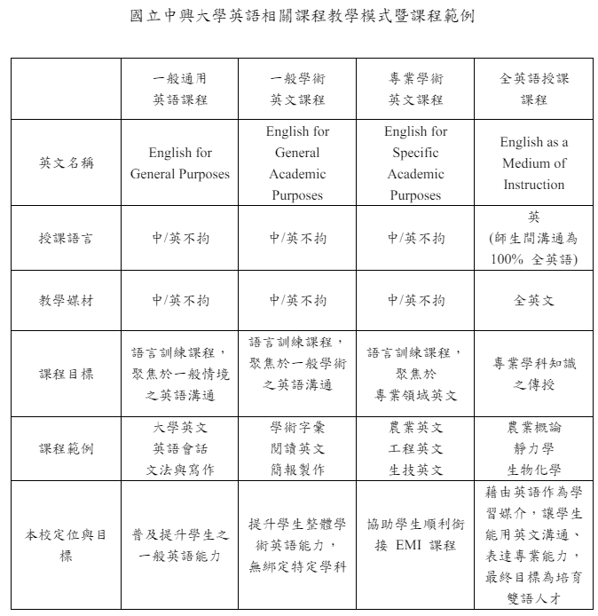
中興大學對ESAP的定義

Slide 3



中興大學的ESAP課綱領域選擇

Slide 4


本中心規劃發展領域
農業與生物科學領域
機械與電機工程領域

Slide 5
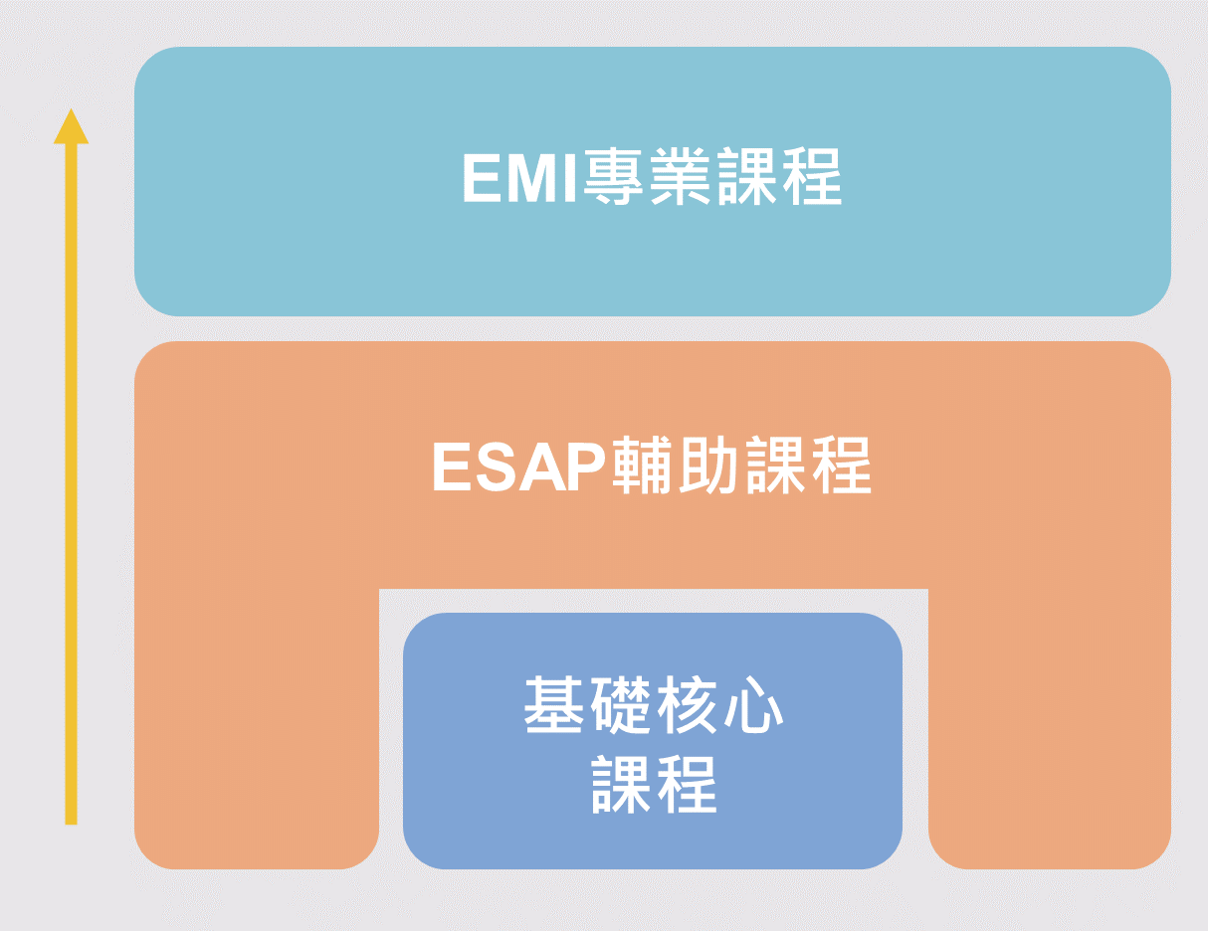
ESAP 配合各階段課程架構
ESAP
輔助
課程群
基礎核心課程群
EMI專業
課程群
課程交集
模組化

Slide 6
課程架構: 以生命科學系為例
EMI專業課程
分子生物學
細胞生物學
生態學
動物生理學
輔佐學生更順利接軌EMI專業課程
ESAP輔助課程
生科英文
生物英文
以基礎核心課程、ESAP輔助課程奠定學生之專業及英文的基石，促進語用能力與專業知識之結合
基礎核心課程
普通生物學

Slide 7

ESAP 課程執行要項
與語言中心之
英文教師討論
與開設ESAP課程
之教師討論
培養學生英語能力
課堂演練比重增加
課堂難易度調整
ESAP教材對應
培養學生英語應用能力
設定目標培養之學生英語能力（聽、說、讀、寫）
學生利用演練中，增加英語口語、聽力練習時間
教師依據學生英語相關測驗結果，調整課堂語言難易度
ESAP教材內容須與對應基礎核心課程或EMI專業課程
可運用英語進行重點摘錄、歸納和概念表達的能力，
甚至運用於研究結果的表達及分析

Slide 8
課綱發展流程
STEP 1
課程盤點分類 基礎、核心、進階
STEP 2
學科專業老師提供專業課程核心內容
STEP 3
學科專業老師和語言教師討論 ESAP課綱架構及研發教材內容

Slide 9

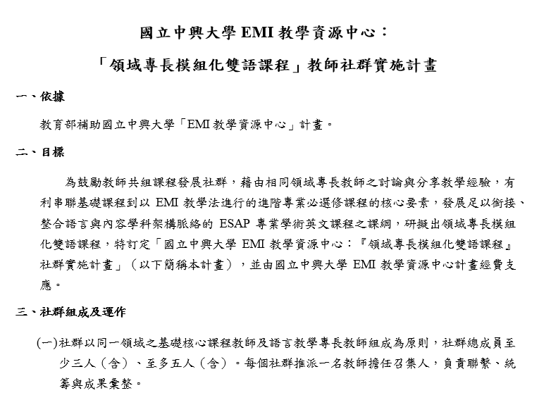

執行辦法 - 「領域專長模組化雙語課程」教師社群
社群組成
同一領域之基礎核心課程教師及語言教學專長教師組成，社群總成員3-5人
社群活動
1.課程盤點：盤點該領域基礎核心課程與EMI進
階專業課程
2.ESAP課綱研發：依據課程盤點之串聯發展ESAP課綱，使ESAP同時發揮輔助及接軌功能
社群管考
需繳交結案報告（含ESAP課綱）
社群募集中

Slide 10
初步成果 - 112-2學期農業英文課綱 1/2
課程名稱 | 農業英文 English for Agriculture | 類別 | 選修
開課單位 | 農業暨自然資源學院 | 選課單位 | 農業暨自然資源學院
課程簡述 | This interdisciplinary course across sciences, humanities, and language learning is designed for students who plan to take agriculture and/or relevant course entirely in English. Major topics includes agri-food education, biological diversity, and sustainable agriculture. Vocabulary, terms, key facts and concepts from the discipline would be introduced in order to prepare students for their academic learning. In addition, the course encourages a humanistic approach to culinary cultures, food consumerism, and the environment. Students would not only enhance their skills in reading, listening, speaking but develop their critical thinking through class activities and assignments.
課程目標 | The course is more focused, more oriented towards profession. The main objective of this course is: 1. To better prepare students for future professional activities in the field of agriculture. 2. To introduce how English language is presented in a true context of agriculture. 3. To help students understand how the language they will need to use in the field functions of agriculture.

Slide 11
初步成果 - 112-2學期農業英文課綱 2/2
週次 | 授課內容 | 週次 | 授課內容
第 1 週 | Course Orientation Farming & Apocalypse: Video Watching & Discussion[w/online essay questions] | 第 10 週 | Presentation(session 2): 2-minute Oral PPT Presentation
第 2 週 | Topic 1: What is Agriculture & Why Farming can Feed the World during an Apocalypse T1_Part 1:“How to Farm During a Zombie Apocalypse”: Video watching & Discussion(1) | 第 11 週 | Topic 3: Biodiversity T3_Part 1: What is Biodiversity
第 3 週 | T1_Part 1:“How to Farm During a Zombie Apocalypse”: Animation Watching & Discussion(2) | 第 12 週 | T3_Part 2: Invasive Species
第 4 週 | T1_Part 2: “The Art and Science of Agriculture”: Article reading & Discussion | 第 13 週 | Topic 4_part 1: What is “Sustainable Agriculture”?: From Food Security to Sustainability -Video watching & discussion
第 5 週 | T1_Part 3: Conclusion | 第 14 週 | Topic 4_part 2: What is “Sustainable Agriculture”?: On Eating Bugs - How to make an argument
第 6 週 | Topic 2: What is Urban Farming T2_Part 1: On Urban Farming: Video Watching & Discussion_Can we create the ”perfect” farm?(TED-Ed) | 第 15 週 | Final Oral PPT Presentation(1)
第 7 週 | No class: Spring break | 第 16 週 | Final Oral PPT Presentation(2)
第 8 週 | T2_Part2: Successful Cases: Cases from Singapore and Thailand. - How to make a summary | 第 17 週 | Online self-learning
第 9 週 | Presentation(session 1): 2-minute Oral PPT Presentation | 第 18 週 | Online self-learning
9

Slide 12
初步成果 - 112-1學期生物科技英文課綱 1/2
修改自本校徐筱玲老師之課綱
課程名稱 | 生物科技英文 English for Biotechnology | 類別 | 選修
開課單位 | 不限系所 | 選課單位 | 不限系所
課程簡述 | English for Biotechnology is designed to provide you with the language skills required to navigate the vast array of texts and literature related to biotechnology. As advancements in biotechnology continue to shape the world, it is essential to equip yourself with the language and communication abilities to contribute effectively to this field. The course will include a blend of interactive lectures, group discussions, reading comprehension exercises, vocabulary-building activities, writing assignments, and oral presentations. We will also utilize authentic biotechnological texts to expose you to the language used in the field.
課程目標 | 1. Develop Academic Reading Skills: We will focus on enhancing your ability to read and comprehend various texts in English related to biotechnology, including research papers, scientific articles, and industry reports. You will learn to extract key information and understand the nuances of specialized language. 2. Expand Biotechnology Vocabulary: Building a robust and domain-specific vocabulary is crucial for effective communication in biotechnology. You will acquire terminology related to genetic engineering, bioinformatics, bioprocessing, molecular biology, and more. 3. Analyze Technical Language: As biotechnology involves intricate technical concepts, we will delve into the analysis of technical language used in academic literature. This will enable you to interpret and discuss complex ideas confidently. 4. Academic Writing Practice: You will have the opportunity to practice writing within the biotechnology context, including essays, summaries, and scientific reports. Focus will be on clarity, precision, and adherence to academic conventions. 5. Presenting Biotechnological Concepts: Effective oral communication is vital in any scientific field. You will learn to present biotechnological concepts, research findings, and proposals with clarity and confidence.
10

Slide 13
初步成果 - 112-1學期生物科技英文課綱 2/2
修改自本校徐筱玲老師之課綱
週次 | 授課內容 | 週次 | 授課內容
第 1 週 | Orientation | 第 10 週 | Chapter 3 - The Mystery of the Human Brain Lesson 1 Inside Your Brain Lesson 2 The Chemicals of Love
第 2 週 | Chapter 1 - Genetic Engineering Lesson 1 Bringing Back the Dead Lesson 2 The Human Genome Project | 第 11 週 | Chapter 3 - The Mystery of the Human Brain Lesson 2 The Chemicals of Love Lesson 3 Memory Tricks
第 3 週 | Chapter 1 - Genetic Engineering Lesson 2 The Human Genome Project Lesson 3 Super Babies | 第 12 週 | Chapter3- The Mystery of the Human Brain Lesson 2 The Chemicals of Love Lesson 3 Memory Tricks
第 4 週 | Chapter 1 - Genetic Engineering Lesson 3 Super Babies Lesson 4 Are Your Genes Really Yours? | 第 13 週 | Chapter 4 - Great Discoveries in Biotechnology Lesson 1 Darwin and The Origin of Species Lesson 2 The Discovery of Helicobacter pylori
第 5 週 | Writing focus | 第 14 週 | Chapter 4 - Great Discoveries in Biotechnology Lesson 3 Chance Favors Only the Prepared Mind—The Discovery of Penicillin Lesson 4 The Mindset of a Nobel Laureate
第 6 週 | Chapter 2 – Influenza Lesson 1 Influenza Lesson 2 The 1918 Influenza Pandemic | 第 15 週 | Final presentations
第 7 週 | Chapter 2 – Influenza Lesson 2 The 1918 Influenza Pandemic Lesson 3 Can birds catch a cold? – Avian influenza | 第 16 週 | Review and feedback
第 8 週 | Chapter 2 – Influenza Lesson 3 Can birds catch a cold? – Avian influenza Lesson 4 Vaccines | 第 17 週 | Self-directed learning
第 9 週 | Midterm examination | 第 18 週 | Self-directed learning

Slide 14
未來發展
1
院系所
課程盤點
5
EMI教學
資源中心
(ESAP資料庫)
2
分領域
提出
開課需求
4
研發
ESAP課綱
3
籌組發展
課綱教師

Slide 15

EMI 教師培訓課程

Slide 16

跨學群觀課社群

Slide 17
歡迎討論與指教
報告結束感謝聆聽
Notes:
補充-目前進度
已擬定「領域專長模組化雙語課程」教師社群實施計畫（草案）

